Slide 1

New York Yellow Taxi Data Processing Project
Nora Ayaz

Slide 2
New York Yellow Taxi Data Processing Project;
What is this project about? This project automates downloading, processing, and analyzing New York Yellow Taxi trip data.
Why is it important? It saves time and ensures accurate, up-to-date data for analysis.
Key Components:
Data Source: NYC Yellow Taxi trip data.
Technologies Used:
Azure Data Lake
Databricks Notebooks
Azure Data Factory
Azure Synapse Analytics

Slide 3
Project Architecture and Data Flow
Data Source
Raw Data Upload
Azure Data Lake (raw/ folder)
Metadata Management
Tracking which files have been processed
Data Transformation
Processed Data Storage
Automated Pipeline
Yellow Taxi trip data (publicly available)
Databricks processes the data: clean, transform, and add new features
Azure Data Lake (processed/ folder)
Azure Data Factory ensures everything runs on schedule

Slide 4
Notebook Details: Automating ETL Processes
Notebook 1: Extract Data
Purpose: Downloads raw data files and uploads them to Azure Data Lake.
Key Features:
Checks for new files only.
Ensures no duplicates are uploaded.
Process:
Fetch files from the public URL.
Upload them to the raw/ folder in Azure Data Lake.
Notebook 2: Metadata Management
Purpose: Tracks processed files using a metadata file.
Key Features:
Maintains a JSON file (processed_files.json) in the processed_combined/ folder.
Prevents reprocessing of files.
Notebook 3: Transform & Load
Purpose: Cleans, transforms, and saves processed data.
Key Features:
Filters invalid data (e.g., negative trip distances).
Adds new features:
Trip duration in minutes.
Tip ratio (tip amount / total amount).
Distance segment (short, medium, long).
Combines new data with existing data.

Slide 5

Pipeline and Automation
Trigger
Notebook 2: Metadata Management
Notebook 3: Transform & Load
Notebook 1: Extract Data
ADF_datapipeline
This pipelines runs monthly to keep data updated.
GitHub_extract_data
Pipeline_parameters
Inspect_webelement
ADLS_raw_folder
GitHub_metadata
ADLS_processed_files.json
GitHub_transform
ADLS_processed_files.csv

Slide 6
Outputs and Results
Data Pipeline Outputs:
Processed Data Saved:
Processed data is stored in the processed_combined/ folder in Azure Data Lake.
Data is cleaned, enriched, and ready for analysis.
Metadata File:
Tracks processed files to ensure no duplicates.
Key Transformations:
Filtered invalid trips (e.g., negative distances, invalid timestamps).
Added new features:
Trip Duration: Duration calculated in minutes.
Tip Ratio: Tip amount as a percentage of total fare.
Distance Segment: Trips categorized as short, medium, or long.

Slide 7
New York Taxi Service Analysis Overview
Objective: To analyze the performance of New York taxi services using data-driven insights.
Key Focus Areas:
Overall operational health (trips, revenue, distances).
Vendor-specific performance comparisons.
Regional profitability and customer behavior trends.

Slide 8
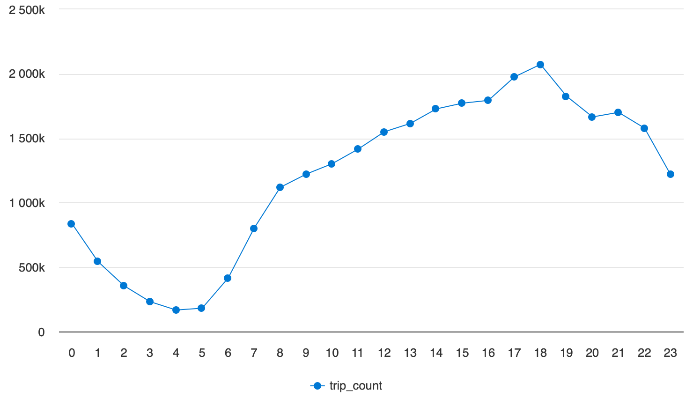
Key Metrics: Operational Insights
Total Trips Analyzed: | 29.1 million trips
Revenue Generated: | $825.9 million
Average Trip Distance: | 5 miles
Peak Hours: | 4 PM - 7 PM

Slide 9
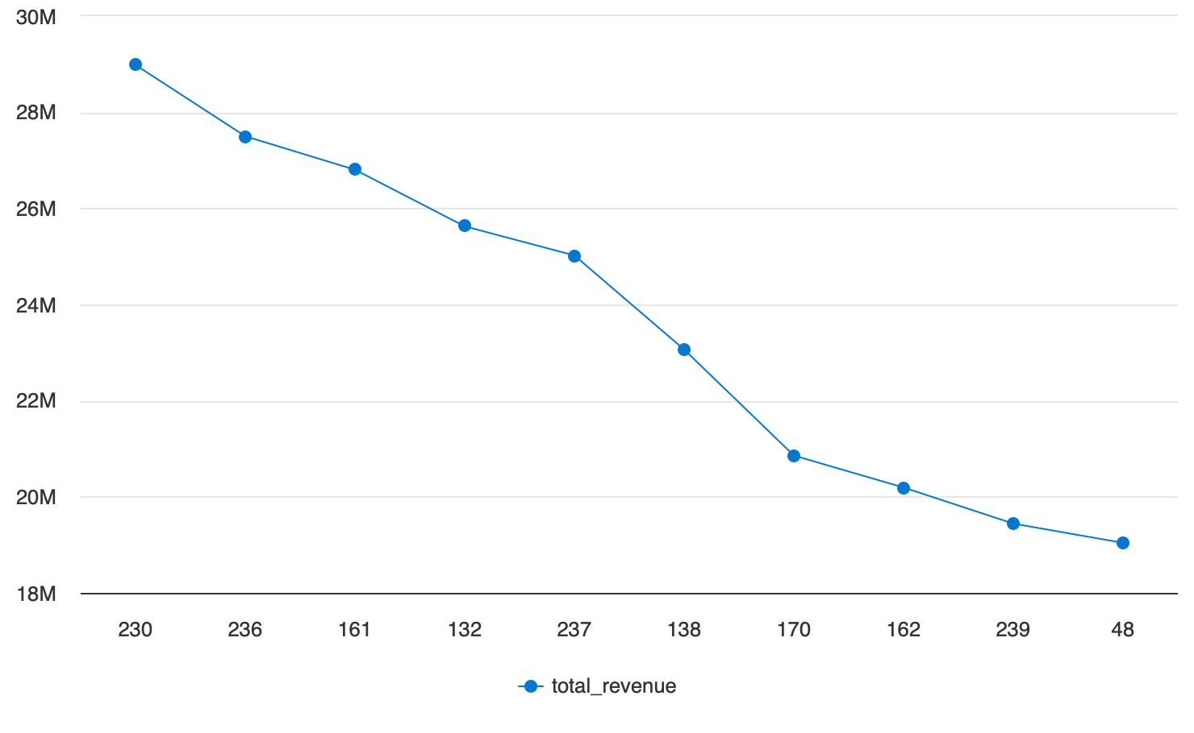
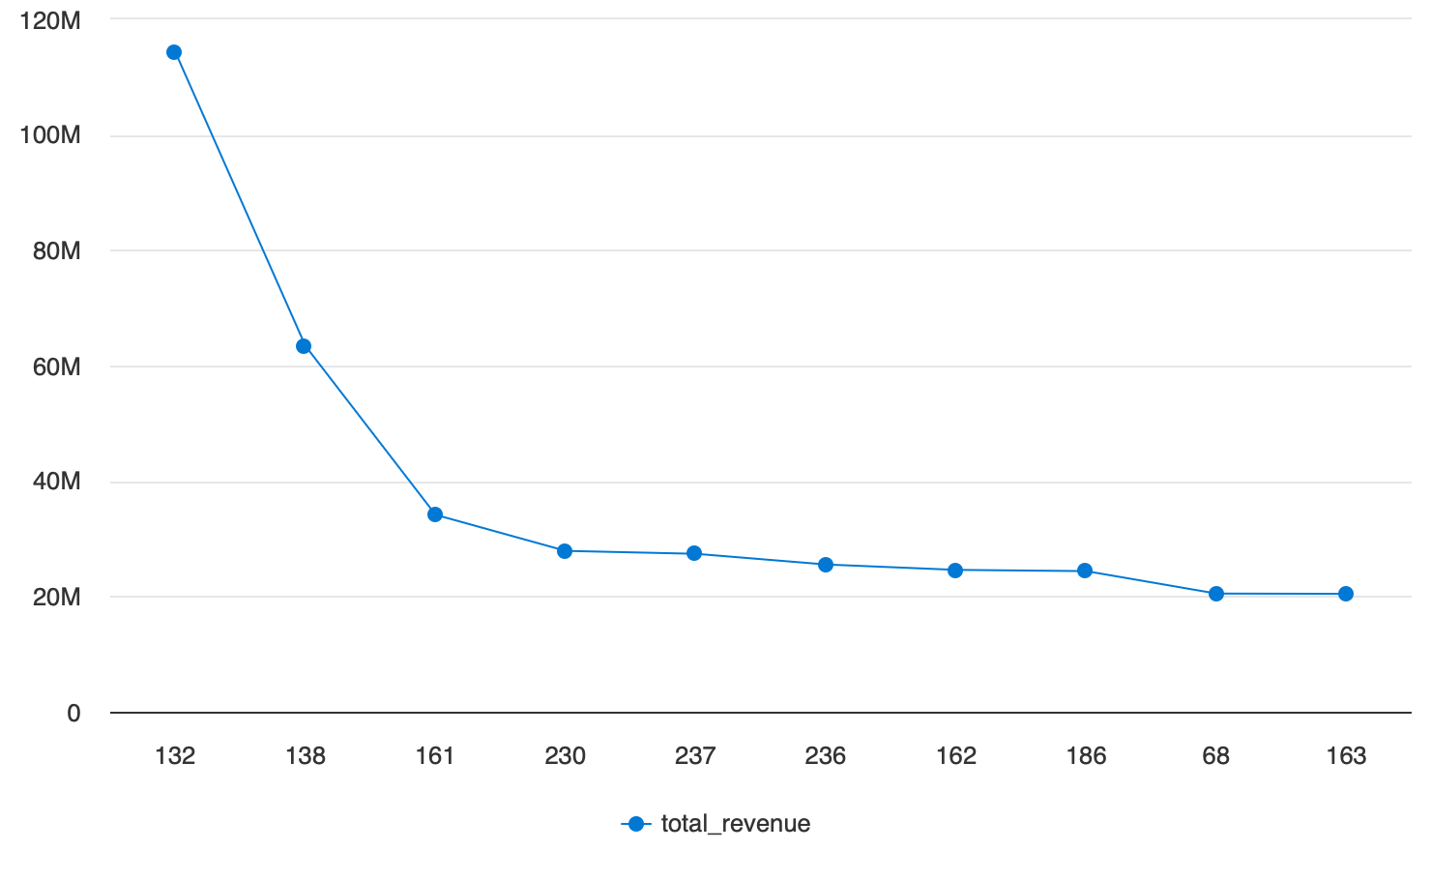
Most Profitable Locations: Pickup & Drop-off
Top Pickup Locations:
Location 230: $114M
Location 138: $63M
Location 161: $34M
Top Drop-off Locations:
Location 230: $29M
Location 236: $27M
Location 161: $26M

Slide 10
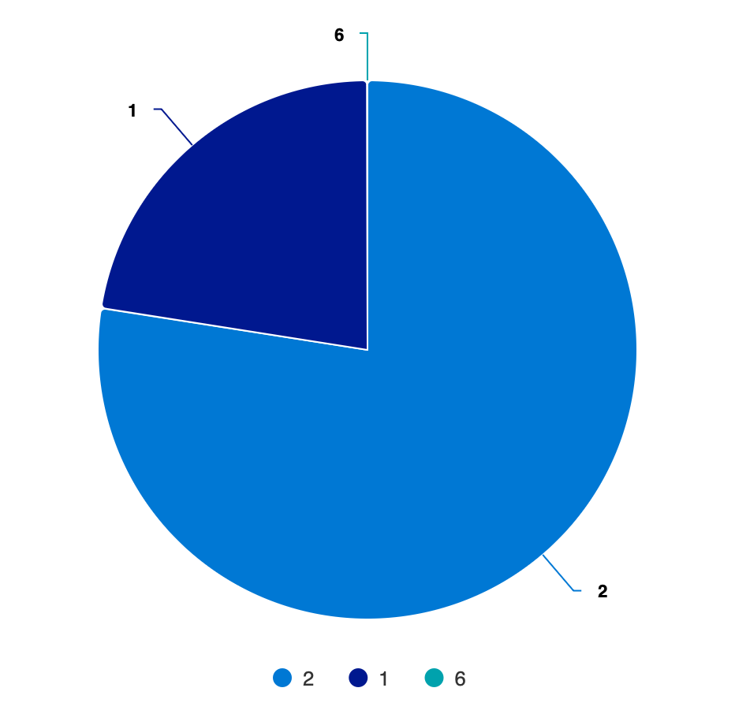
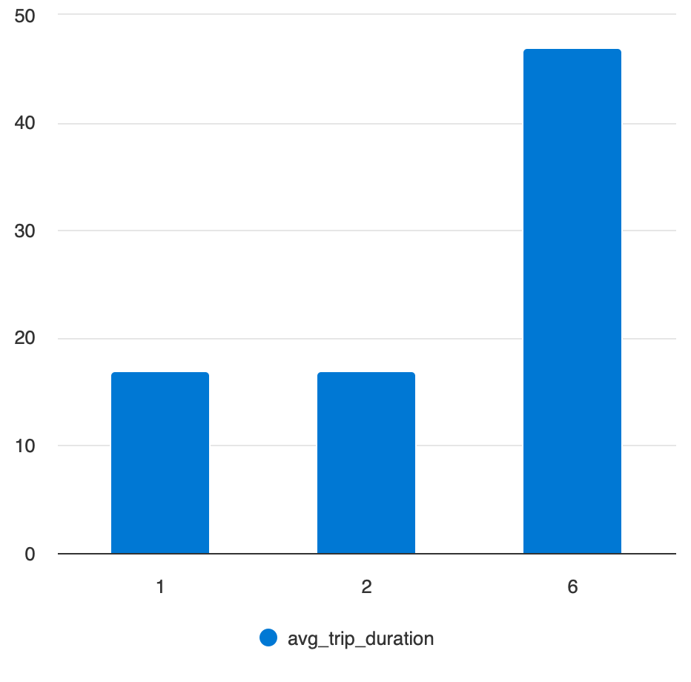
Vendor Performance Comparison
Average Trip Duration:
VendorID 6: 47min
VendorID 2: 17min
VendorID 1: 17min
Revenue Generated:
VendorID 6: 51K
VendorID 2: 639M
VendorID 1: 185M

